Slide 1


Computer
Fundamentals
Dr. Safdar Nawaz Khan
Marwat
DCSE, UET
Peshawar
Lecture 1
safdar@uetpeshawar.edu.pk

Slide 2
Tentative Grading
Criteria
➢ Exams
❑ Final Exam: 50%
❑ Mid Term Exam: 25%
➢ Sessional
❑ Assignments: 10%
❑ Quizzes: 10%
❑ Rest:
5%
safdar@uetpeshawar.edu.pk
2

Slide 3
Academic Honesty
➢ Submit and present own work
❑ Copied statement to be “double quoted” and referenced
❑ Ideas and facts from other sources to be referenced
❑ Figures and tables from other sources allowed
➢ Students to be awarded ‘F’ grade if
❑ Reported work of others without reference
only
if
referenced
❑ Collaborated excessively in
❑ Found to have cheated e.g.
o Copied or shared reports
o Copied during examination
➢ Repeated infractions will
❑ Failure in the course
❑ Disciplinary action
individual tasks
result in
safdar@uetpeshawar.edu.pk
3

Slide 4

Warning
➢ No
mobile
phone
usage
during
Lecture
safdar@uetpeshawar.edu.pk
4

Slide 5
Resource Material
➢ Course Book
❑ Introduction to Computers, Peter Norton,
➢ Reference Book
7th
or
8th
Edition
❑ Discovering
Computers,
Shelly,
Cashman
and
Vermaat,
2008
safdar@uetpeshawar.edu.pk
5

Slide 6
General Discussion
i.
ii.
Learning method (College vs University)
How many of
you
you
have a personal computer?
can install OS and other application
iii. How many of
softwares?
iv. How
many
many many
of
of of
you
you you
can do typing?
have email and social media
v.
How
accounts?
vi. How
can
troubleshoot
PC?
safdar@uetpeshawar.edu.pk
6

Slide 7
Course Group
https://groups.yahoo.com/group/2017_CF_fall
safdar@uetpeshawar.edu.pk
7

Slide 8
Course Outline
➢
➢
➢
➢
➢
➢
➢
➢
➢
➢
➢
➢
➢
Introduction to Computer
Interacting with Computer
Hardware & Software
Information Processing
Number Conversions
Logical Operations
Processors
Storage Devices
Operating Systems
Computer Networks
Data Communication
Computer Programs
Flowchart and Pseudocode
safdar@uetpeshawar.edu.pk
9

Slide 9
Introducing Computer Systems
➢ Exploring computers and their uses
❑ The computer defined
❑ Computers
❑ Computers
❑ Computers
for individual users
for organizations in society
➢ Looking inside the computer system
❑ The parts of a computer system
❑ The information processing cycle
❑ (Essential computer) hardware
❑ Software (brings
❑ Computer data
❑ Computer users
machine
to
life)
safdar@uetpeshawar.edu.pk
10

Slide 10
The Computer Defined
➢ Electronic device
❑ Converts data into information
➢ Modern computers are digital
❑ Two digits combine to make data
➢ Older computers
were analog
❑ A
range
of
values
to
make
data
safdar@uetpeshawar.edu.pk
11

Slide 11
Computers for Individual
Use
➢ Desktop computers or microcomputers
❑ Once, the most common type of computers
❑ Sit on desk or floor
❑ Performs a variety of tasks
➢ Workstations
❑ Specialized computers
❑ Optimized for science or graphics
❑ More
powerful
than
a
desktop
safdar@uetpeshawar.edu.pk
12

Slide 12
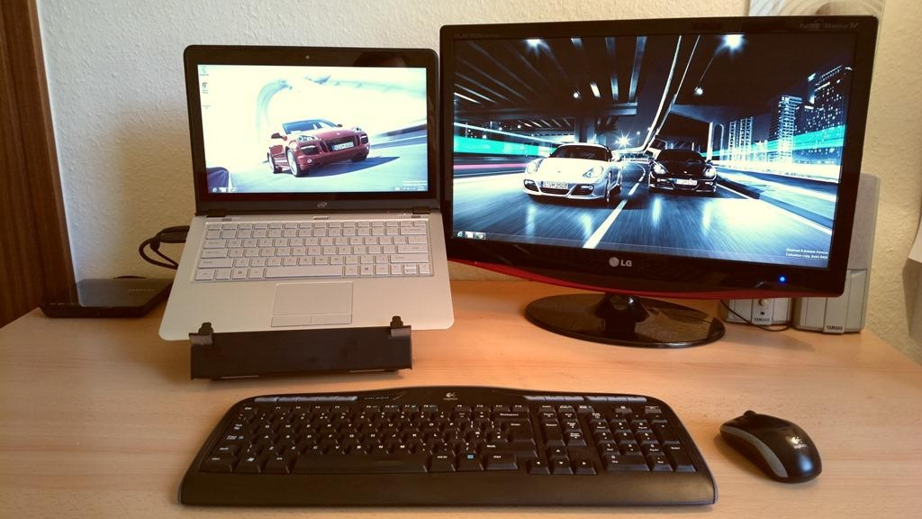
Computers for Individual
Use
(cont.)
➢ Notebook computers
❑ Small portable computers
❑ Weighs between 3 and 8 pounds
❑ About 8 ½ by 11 inches
❑ Typically as powerful as a desktop
❑ Can
include
a
docking
station
Source: http://ultrabooknews.com/2012/09/24/make-your-own-modular-docking-station
safdar@uetpeshawar.edu.pk
13

Slide 13
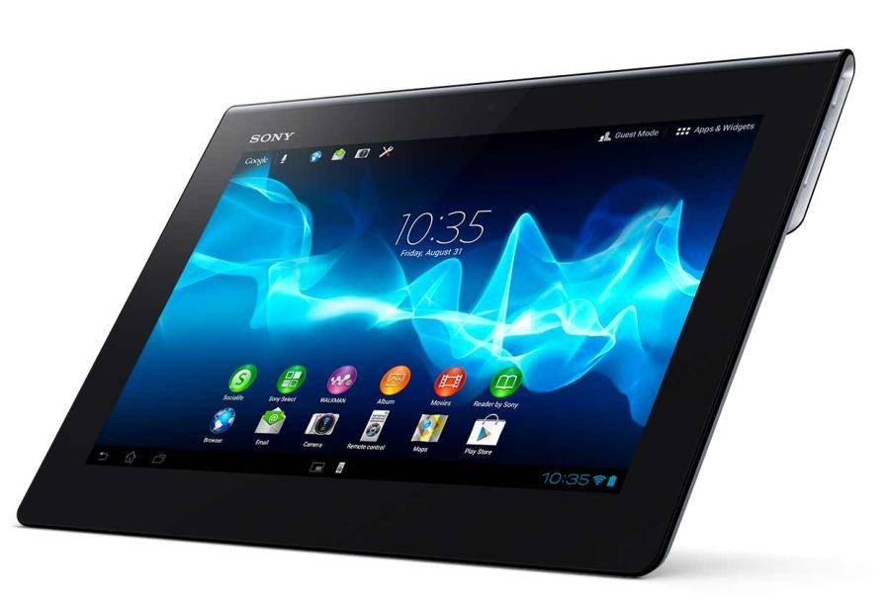
Computers for Individual Use (cont.)
➢ Tablet computers
❑ Newest development in portable computers
❑ Input through pen or touch
❑ Run
specialized
versions
of
office
products
and
apps
Source: http://www.sonymobile.com/global-en/products/tablets/xperia-tablet-s
safdar@uetpeshawar.edu.pk
14

Slide 14
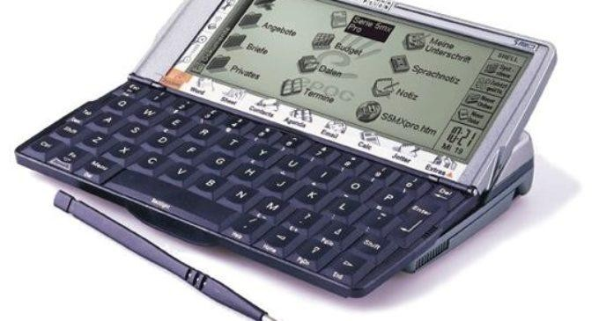
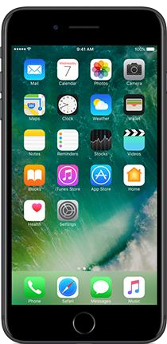
Computers for Individual
Use
(cont.)
➢ Personal Digital Assistants (PDAs)
❑ Handheld computers
❑ Very small computers
❑ Note taking or contact management
❑ Data can synchronize with desktop
➢ Smart phones
❑ Hybrid of cell phone and PDA
❑ Web
surfing,
e-mail
access
Source: http://www.a2z-support.com/psion-series-5-a-personal-digital-assistant-1997
http://www.bell.ca/Mobility/Smartphones_and_mobile_internet_devices
safdar@uetpeshawar.edu.pk
15

Slide 15
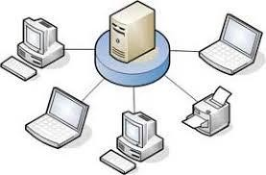
Computers for Organizations
➢ Network servers
❑ Centralized computer
❑ All other computers connect
❑ Provides access to network resources
❑ Multiple servers are called server
farms
❑ Often
simply
a
powerful
desktop
Source: http://atronicsys.com/servers.htm
safdar@uetpeshawar.edu.pk
16

Slide 16
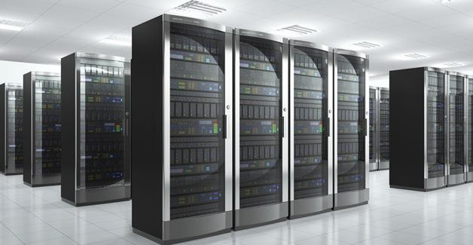
Computers for Organizations
(cont.)
➢ Mainframes
❑ Used in large organizations
❑ Handle thousands of users
❑ Users
access
through
a
terminal
Source: http://blog.syncsort.com/2014/07/offloading-mainframe-hadoop-much-can-save
safdar@uetpeshawar.edu.pk
17

Slide 17
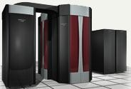
Computers for Organizations
(cont.)
➢ Supercomputers
❑ The most powerful computers
❑ Handle large and complex calculations
❑ Process trillions of operations per
second
❑ Found
in
research
organizations
safdar@uetpeshawar.edu.pk
18

Slide 18
Computers in Society
➢ More impact than any other invention
❑ Changed work and leisure activities
❑ Used by all demographic groups
➢ Computers are important because
❑ Provide information to users
❑ Information is critical to society
❑ Managing information
is
difficult
safdar@uetpeshawar.edu.pk
19

Slide 19
Computers in Society
(cont.)
➢ Computers at home
❑ Many homes have multiple computers
❑ Many Pakistani homes have
Internet
❑ Computers are used
o Online shopping
o Entertainment o Communication o Learning
for
safdar@uetpeshawar.edu.pk
20

Slide 20
Computers in Society (cont.)
➢ Computers
❑ Computer
❑ Computer
➢ Computers
in education
literacy required at all levels knowledge a prerequisite for several
in small business
educational
degrees
❑ Makes businesses more profitable
❑ Allows owners to manage
➢ Computers in industry
❑ Computers are used to design products
❑ Assembly
lines
are
automated
safdar@uetpeshawar.edu.pk
21

Slide 21
Computers in Society (cont.)
➢ Computers in government
❑ Necessary to track data for population
o Police officers
o Tax calculation and collection
❑ Governments were the first computer users
➢ Computers in technology
❑ Advancement in any technological field without
computers
unthinkable
❑ All technologies dependent
❑ Application areas
o Energy monitoring
o Construction
o Agriculture o Automobile o Textile
o Transport
on
computer
safdar@uetpeshawar.edu.pk
22

Slide 22
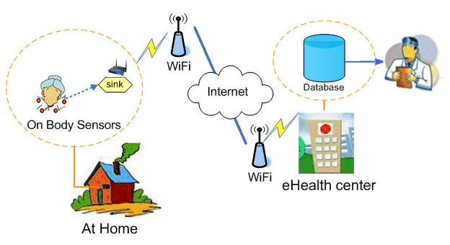
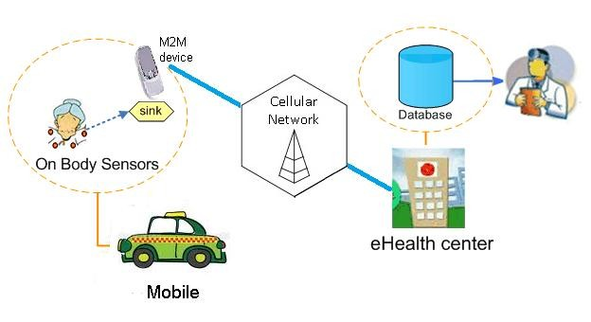
Computers in Society
(cont.)
➢ Computers in healthcare
❑ Revolutionized healthcare
❑ New treatments possible
❑ Scheduling of patients improved
❑ Delivery of medicine is safer
❑ E-healthcare, relationship between healthcare organization and
o Application of internet and related technology
o Improve access, efficiency, effectiveness, quality of health processes
patient
Source: http://bbcr.uwaterloo.ca/~x27liang/seehealthbib.htm
safdar@uetpeshawar.edu.pk
23

